Slide 1
AJAX
Week 12

Slide 2
Today you will learn …
Send data to server via AJAX, and server will store the data to DB
Request one thing from server via AJAX
Request many things form server via AJAX with JSON
Request many things form server via AJAX without JSON

Slide 3
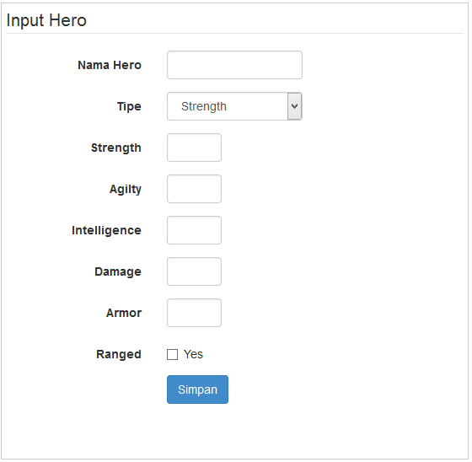
Example 1
Still have this page?
Forget about the picture that should be uploaded along with the data!
Now, use Ajax to send any data from the fields
Catch any respond from server and show it!
In case the save process is success in the server, clear any data form textbox!

Slide 4
Example 1
Let the server echo a string of “0” after the saving process succeed.
Simpanhero.php
  <?php
  // your saving process is here …
  // server will echo a string as a mark for the client that the process is success
  echo “0”
  ?>

Slide 5
Example 1
Client, will catch the message from server:
….
.done(function( data ) {
if(data == ‘0’) {
alert(‘Data saved successfully!’);
// do your process to clear any textboxes here
}
});

Slide 6
Example 2
Let say we want find out the name of a hero that we have already known the id from a textbox.
The client:
// you have two textbox, one is for the ID (user input the id here), and
// the other is for the name (get the name from server via AJAX)
var id = $(‘#txtid’).val();
$.post(‘<your destination>’, {id : id})
.done(function(data)) {
$(‘#txtName’).val(data);
});

Slide 7
Example 2
The Server:
//catch the id first
$id = $this->input->post(‘id’);
// .. Get the name from database
// select name from heroes where hero_id=xxx
// last: echo the result
echo $row[‘name’];
?>

Slide 8
Example 3
At example 2 above, you only find out the name of the hero only. What if we want to find out not only the name of the hero, but all the attributes?
We will use JSON
JSON (JavaScript Object Notation) is a lightweight data-interchange format.
Let say you have an array in php:
$arr = array('satu'=>'a', 'dua'=>'b', 'tiga'=>'c');
In JSON form it will be like this:
{"satu":"a","dua":"b","tiga":"c"}

Slide 9
Example 3
Let’s modify the example 2 you had
The Server:
//catch the id first
$id = $this->input->post(‘id’);
// .. Get all attributes from database
// select * from heroes where hero_id=xxx
// last: echo the result
echo json_encode($row);
?>

Slide 10
Example 3
The client:
// now add others textbox as many as the attributes of the hero table
var id = $(‘#txtid’).val();
$.post(‘<your destination>’, {id : id})
.done(function(data)) {
var jsonResult = JSON.parse(data);
$(‘#txtName’).val(jsonResult.name);
$(‘#txtDamage’).val(jsonResult.damage);
$(‘#txtArmor’).val(jsonResult.armor);
// … continue it …
});

Slide 11
Example 4
At previous weeks, you have a page to show all the hero data in a table. And, above the table there were a textbox and a button. User used that textbox to entry a keyword (hero name) and than click the button to let the server search any hero related to the keyword.
Now, we will search the related data using AJAX.

Slide 12
Example 4
The client
Remove the <form> tag. We don’t need this
Change the button type from “submit” to “button”
In the table, use <tbody> tag and give it an id

Slide 13
Example 4
<table>
<thead>
<tr> …… </tr>
</thead>
<tbody id=‘searchresult’>
………
</tbody>
</table>

Slide 14
Example 4
The contain of the body of the table, will be filled via AJAX
$(‘#buttonSearch’).click(function(){
var keyword = $(‘#txtkeyword’).val();
$.post(‘<your destination>’, {keyword: keyword})
.done(function(data)) {
$(‘#searchresult’).html(data);
});
});

Slide 15
Example 4
The server:
<?php
// get the result from database first
// according the the keyword given
$result = “”;
while($row = $res->fetch_assoc()) {
$result .= “<tr>”;
$result .= “<td>”.$row[‘id’]. “</td>”;
$result .= “<td>”.$row[‘name’]. “</td>”;
// ……… other attributes ……
$result .= “</tr>”;
}
echo $result;
?>

